Slide 1


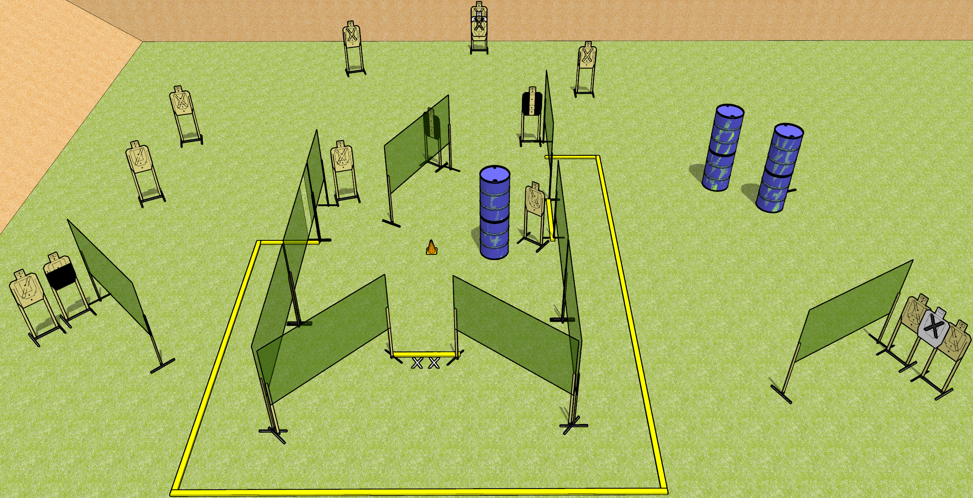
 | Dothan Gun Club – USPSA Match Crazy! Course Designer : Drew Coleman
START POSITION : Standing with both feet on X’s facing downrange, wrists below belt
GUN READY CONDITION : Pistol loaded and holstered. PCC loaded, shouldered, safety on, pointed at orange cone. |  | SCORING: Comstock, X30rounds TARGETS: 15 paper, 0 Steel SCORED HITS: Best 2 on paper, steel until down START-STOP: Audible, last shot RULES:
STAGE PROCEDURE: Engage targets as they become available from within the fault lines.

Slide 2
Crazy!
Written Stage Briefing
Crazy! is a 30 round, 150 point, Comstock field course. There are fifteen USPSA targets. The best two hits on paper will score. The start signal is audible.
Handgun start position is standing with both feet on X’s, facing downrange, wrists below belt. Handgun is loaded and holstered.
PCC start position is standing with both feet on X’s, facing down range. Loaded carbine is held with both hands, shouldered, safety on, with muzzle pointed at orange cone.
On start signal, engage targets as they become available from within the fault lines.

